Slide 1


Slide 2
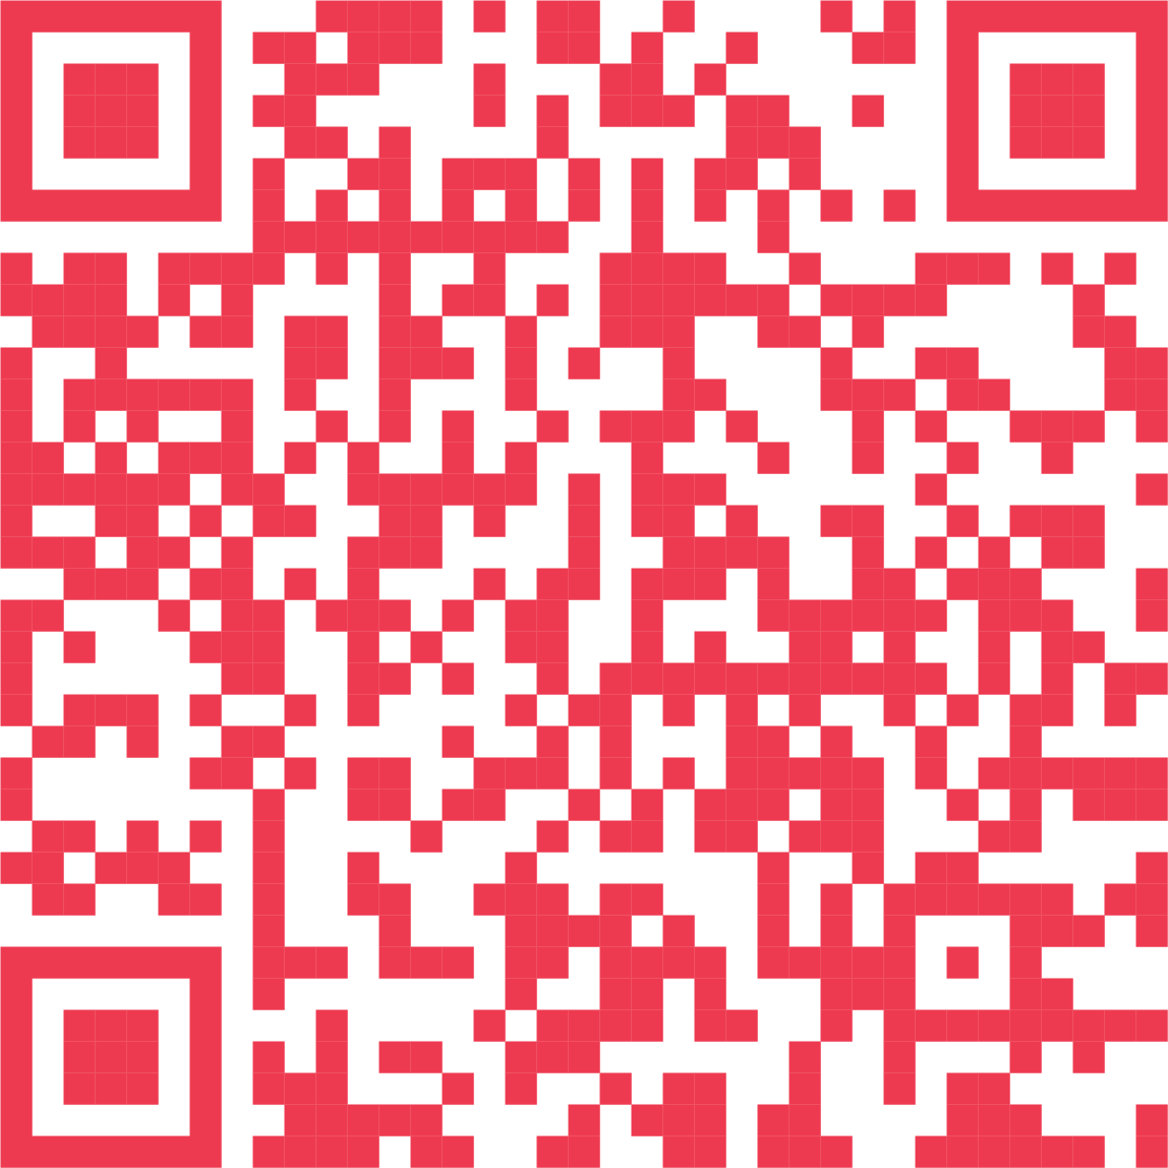

Complete the Workplace Motivators Assessment
A robust tool for measuring a person’s top interests and drivers.
www.motivatorsppd.com
.

Slide 3


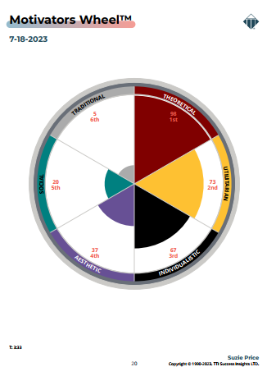

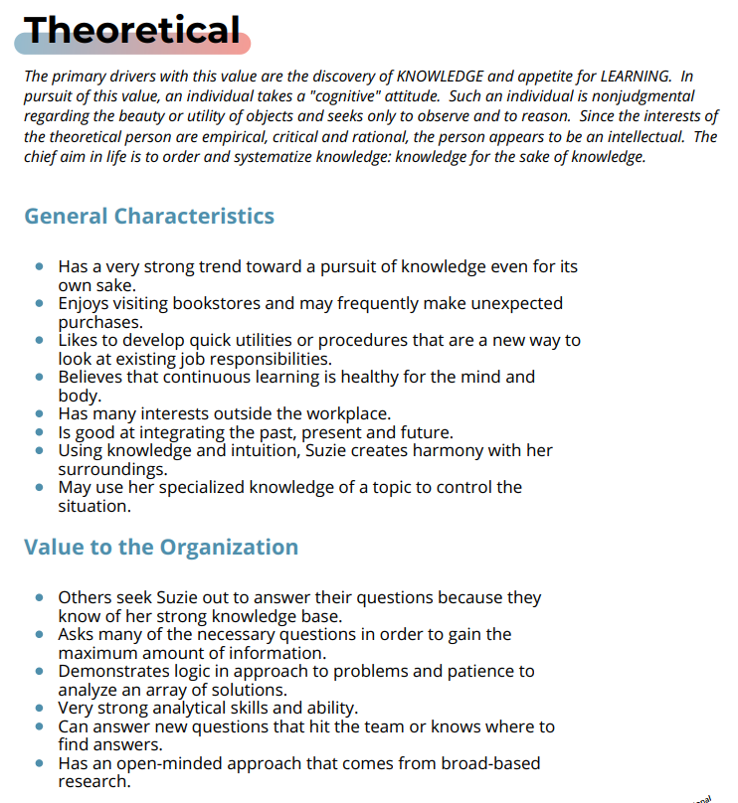


COMMON FEEDBACK
Workplace Motivators Assessment
“This makes sense. I’ve always cared about this.”
“I now know what I need to do more of in my free time and what projects I’m going to jockey for in the future.”
“My Assessment has helped me make sense of that job I struggled in… and why I wanted to change jobs!”
“Now I know why Jane and I disagree on so many things! I know what I need to do to make things better.”
www.motivatorsppd.com

Slide 4

QUICK GROUP SHARE:
What You Said and Felt After Reading Your Report…

Slide 5

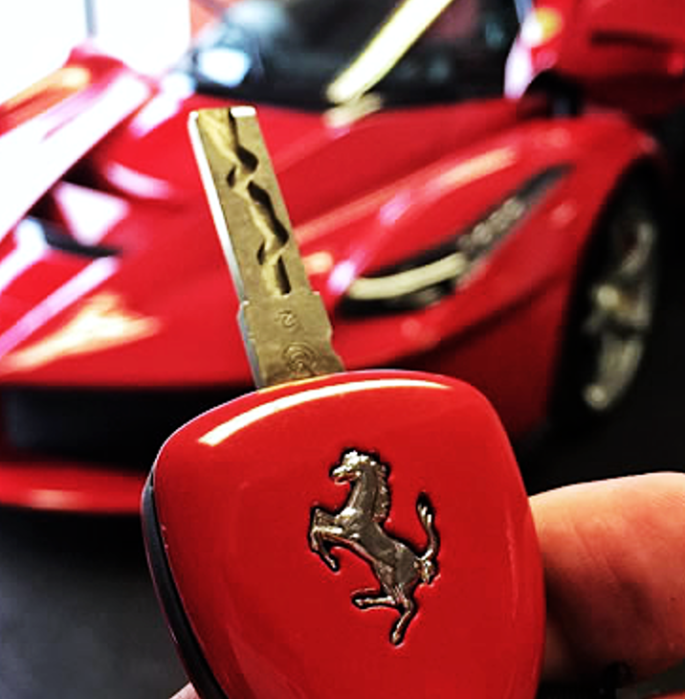

Meeting Objectives
1. Understand Your Top Interests, and What “Puts Gas in Your Tank”
2. Realize and Value Other’s Perspectives, Even When Very Different
3. Use These Insights to Create Wake Up Eager Days, Work and Teams
My Requests: Limit Distractions. Ask ?’s anytime. Parking Lot When Needed.
Apply this to Yourself. Always Know We Are Here to Support You.

Slide 6
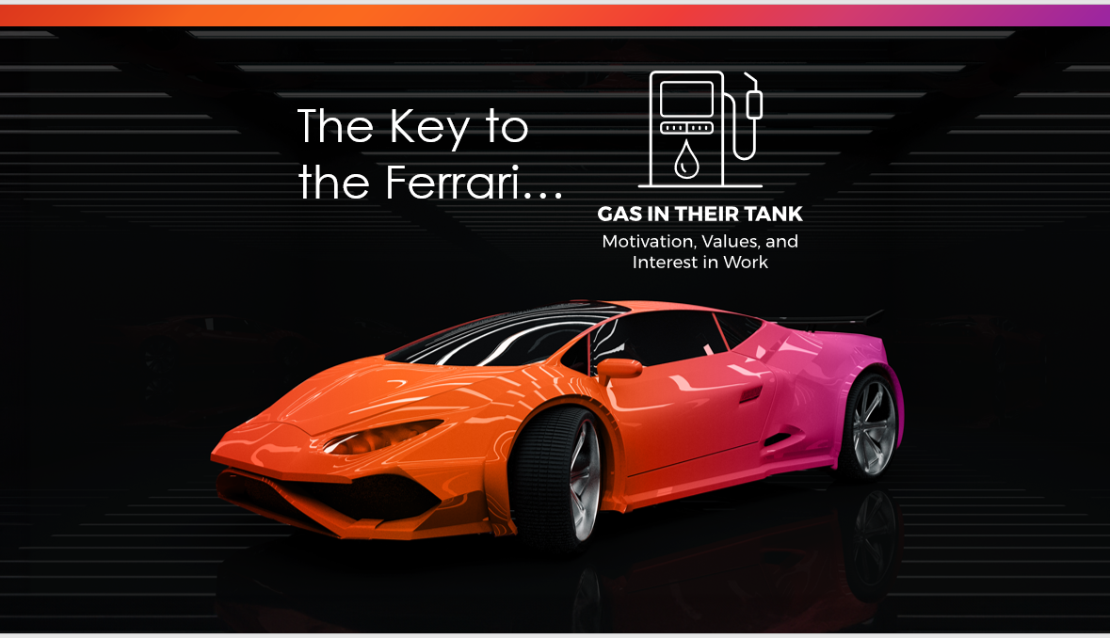


One Science in TriMetrix
WHAT WE WANT TO DO FIVE DAYS A WEEK…
The Key to
the Ferrari…

Slide 7

“When I get to do what I do best every day…”
8%
44%
6X
3X
38%

Slide 8

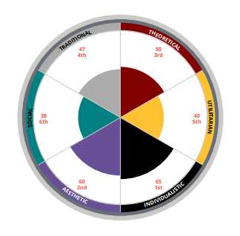

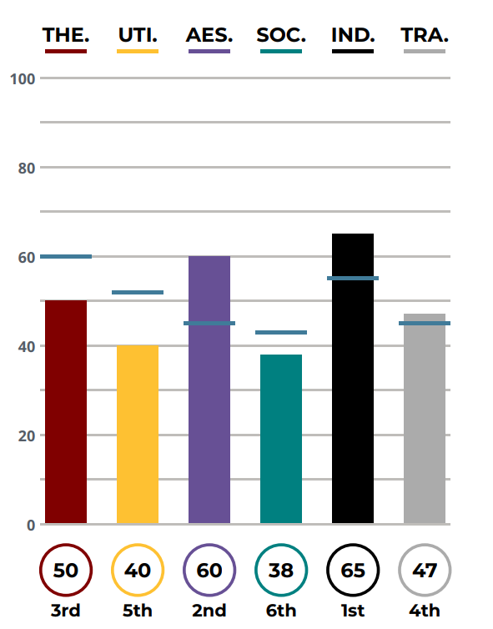
So, what are Workplace Motivators?
The “Why” of our actions
Drives our choices and decisions
Creates engagement when fulfilled
What is automatically important to you
The arena in which you/others like to spend time(‘our peeps’)
How you/others judge people or situations

Slide 9
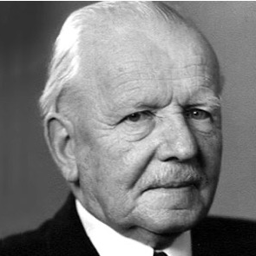

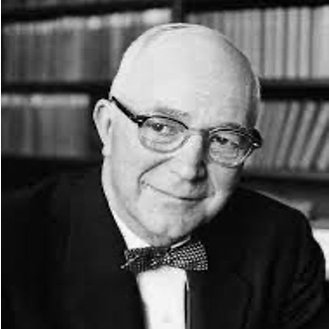

A Little History
“I wanted a better way to account for the complex expression of our soul.”
  Assessment Creator
  Developed and validated the Workplace Motivators Assessment - 1998.
  EEOC Compliant and OFCCP Compliant
Eduard Spranger
  Author, “Types of Men” — 1928
  German psychologist
  Identified the six categories, called attitudes
Gordon Allport
  Psychologist Gordon Allport built on Spranger's work to develop the Study of Values assessment in1931.
  Certified in these tools since 2004.
  Reviewed over 25,000 assessments
  Top 20 Value Added Partner with TTI Success Insights
Notes:
Objective: To understand what the Driving Forces measure and how they can change.
Facilitation:
Review the list.
Ask participants, “If you inherited a 50 million dollar art collection, what would you do with it”?
Answer: most likely one of your primary Drivers Ex. Sell it/Resourceful, Study it/Intellectual, give to a museum/Harmonious.
Transition: Now that we understand the Driving Forces a little more, let’s set some session goals.

Slide 10

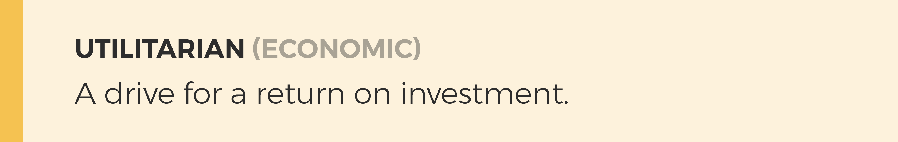
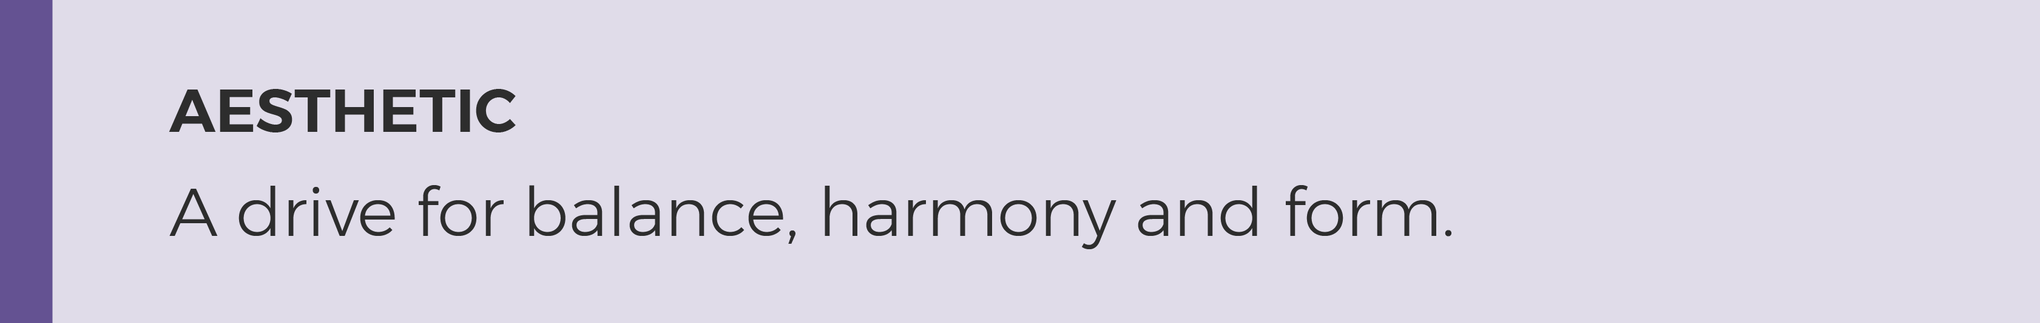
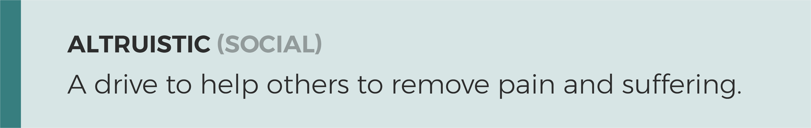
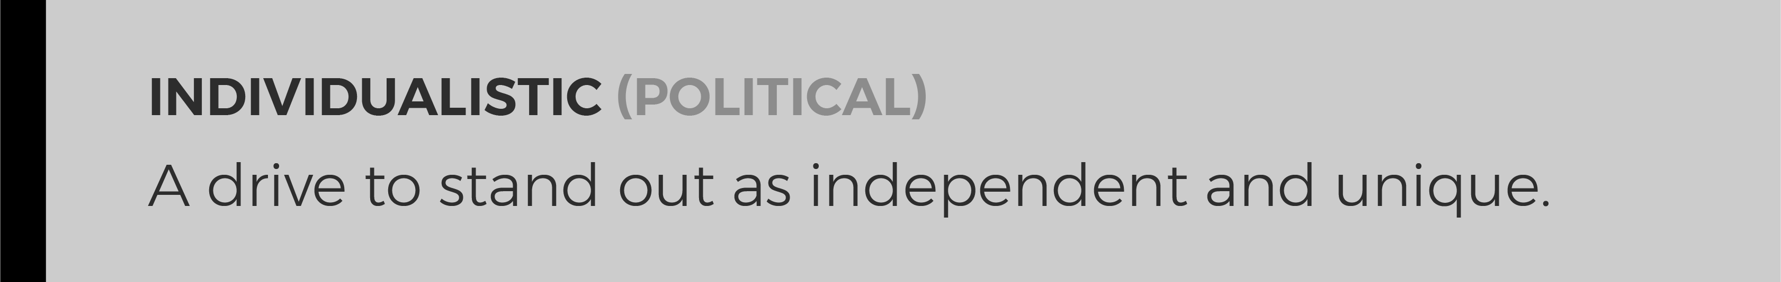
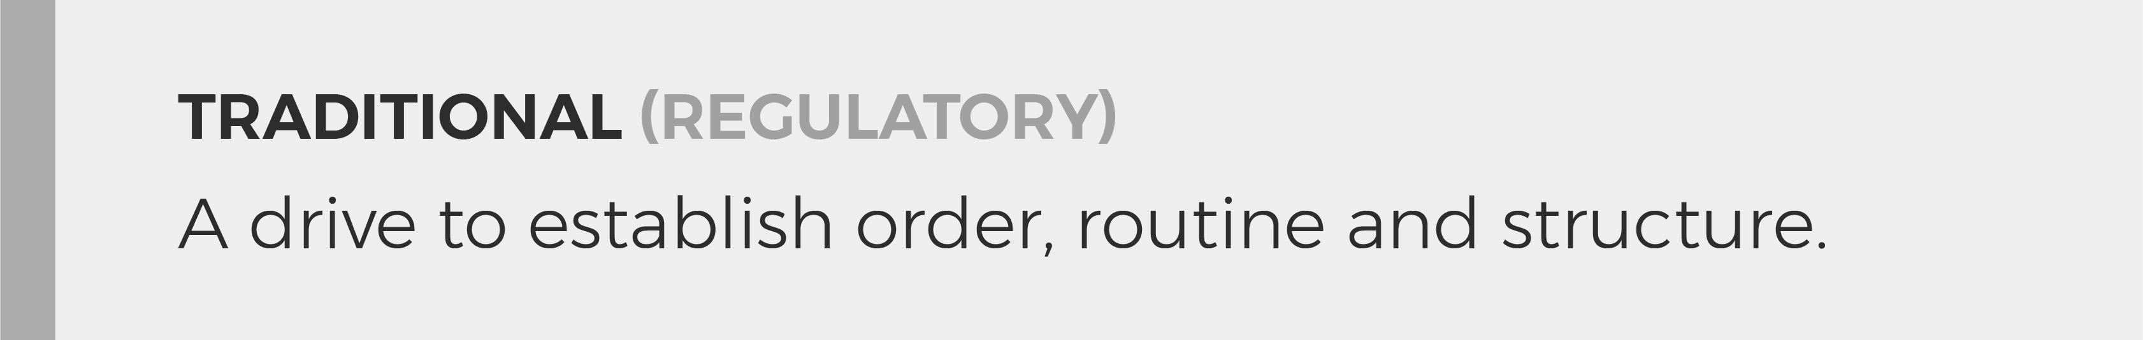
Our top motivators reveal what we are most interested in and how we want to spend our time, SEVEN DAYS a WEEK.
EXPERT
R.O.I.
ENJOY
SERVICE
STAND OUT
RULES
Notes:
Objective: To understand what the Driving Forces measure and how they can change.
Facilitation:
Review the list.
Ask participants, “If you inherited a 50 million dollar art collection, what would you do with it”?
Answer: most likely one of your primary Drivers Ex. Sell it/Resourceful, Study it/Intellectual, give to a museum/Harmonious.
Transition: Now that we understand the Driving Forces a little more, let’s set some session goals.

Slide 11
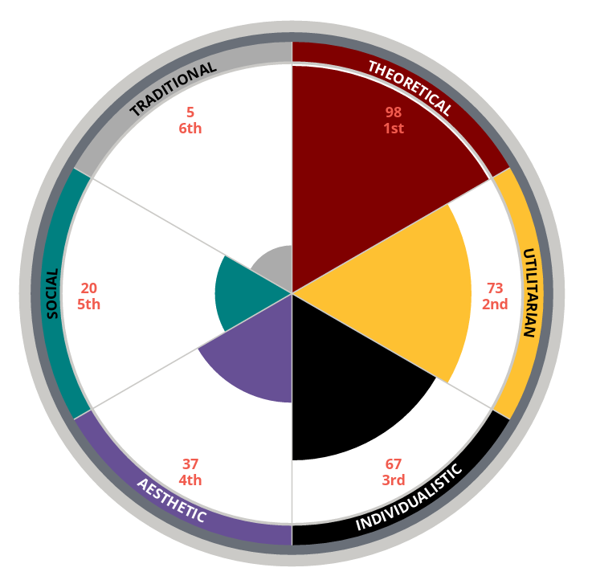
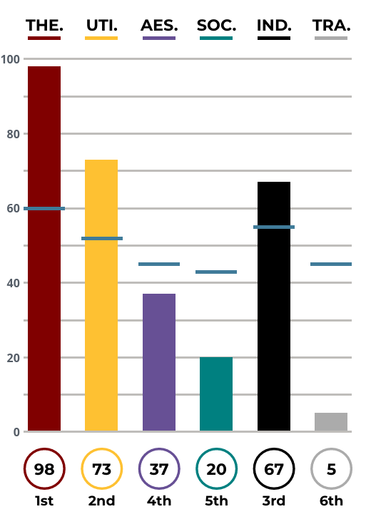
Your Top Interests – Are What Puts “Gas in Your Tank” and Some of Your Greatest Strengths…
Your Turn!
Pages 4 & 7
Your MOST
Interested: #1, #2
Your LEAST
Interested: #6

Slide 12

A Look at Your Motivators
Your #1, #2, (MOST/Energizer) and #6 (LEAST/Stressor) are what drive you to act
Not “good or bad” or “right or wrong”
Not about ability, but are about INTEREST
They reveal what stresses us out and what we can tend to overdo
With awareness, you can manage stress and what you may overdo
They may reorder as life circumstances change
Goal: Self Awareness. Other Awareness. Job Fit Match. Understand Energy, Interest and Stress.

Slide 13
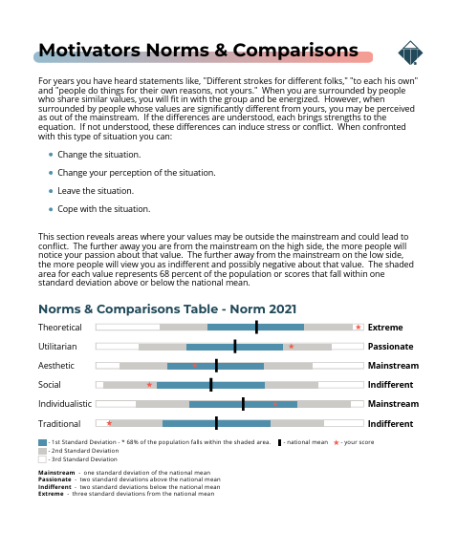
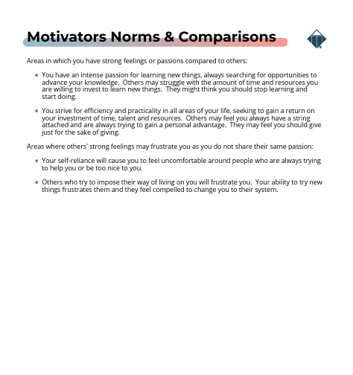
Check the Intensity
Motivators Norms & Comparisons
Pages 5 & 6
Mainstream?
Passionate?
Indifferent?
Extreme?

Slide 14
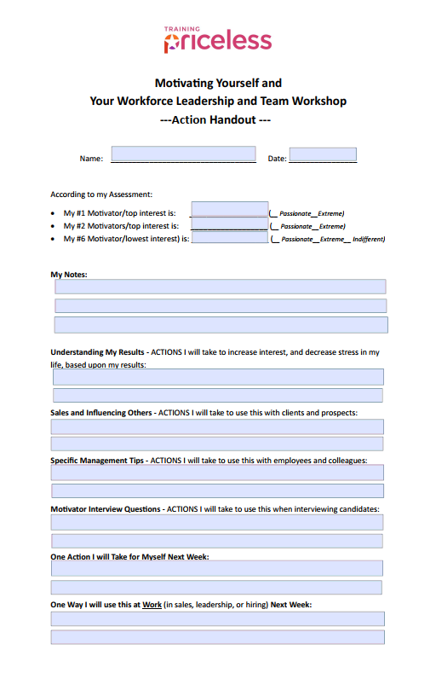
Action Handout – Understanding my Results

Slide 15
One Science in TriMetrix
Small Group Breakout – Understanding My Motivators
The Key to
the Ferrari…

Slide 16
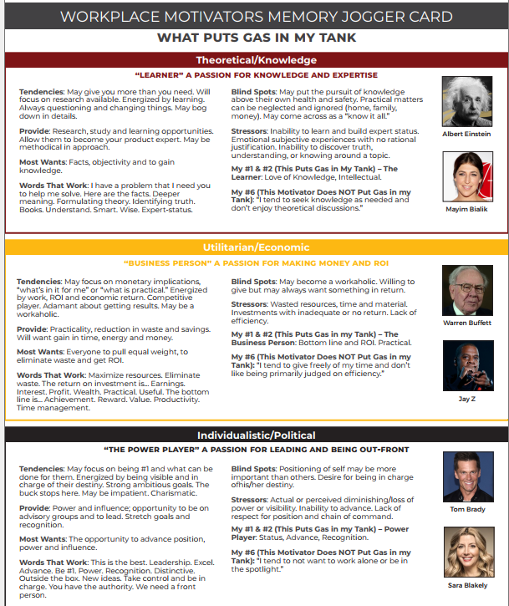
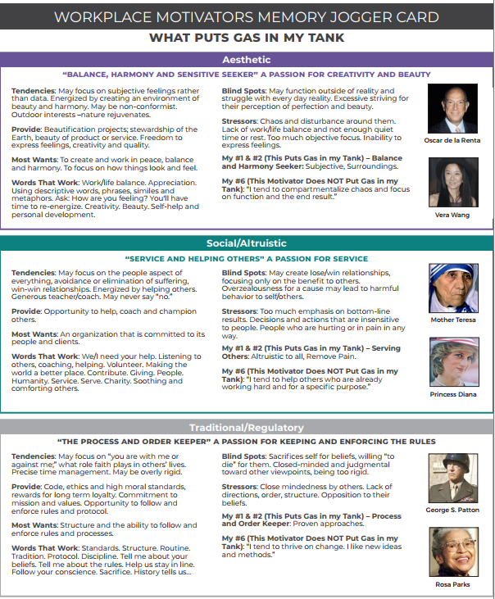
Read the Section
Related to Your Most Interested, #1 #2 Motivators.
Pick a statement that
stands out. Think about
how this shows up in your
life and work.
Read the Section Related to Your Least Interested, #6 Motivator.
Think about how this shows up in your life and work?
#1
#2
#6
#1 & #2 WHAT WE WANT TO DO FIVE DAYS A WEEK…

Slide 17
“The person (people) who most influenced my top
motivators may have been…”

Slide 18
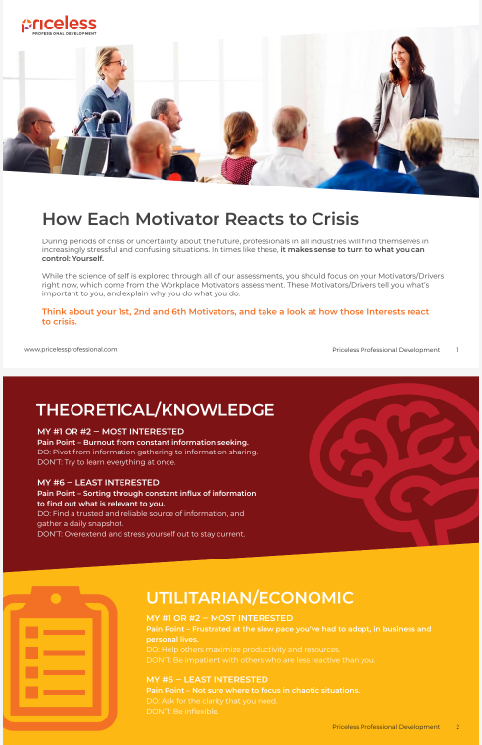
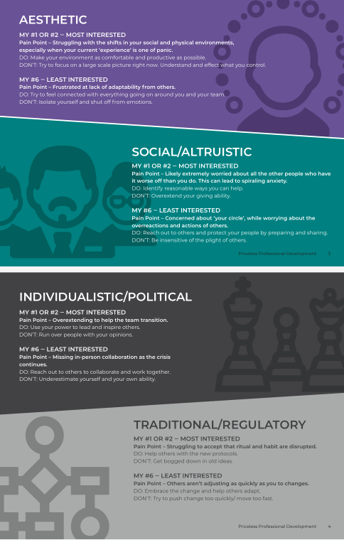

Slide 19
Action Handout – Understanding my Results

Slide 20
One Science in TriMetrix
Group Discussion – Understanding Other’s Motivators
The Key to
the Ferrari…

Slide 21
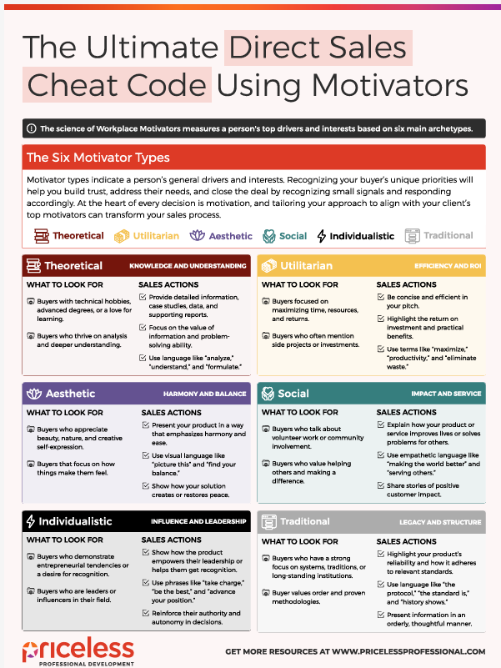
Sales and Influencing Other’s Exercises

Slide 22
Action Handout – Sales and Influencing Others

Slide 23
One Science in TriMetrix
Group Discussion –
Specific Management
Tips
The Key to
the Ferrari…

Slide 24
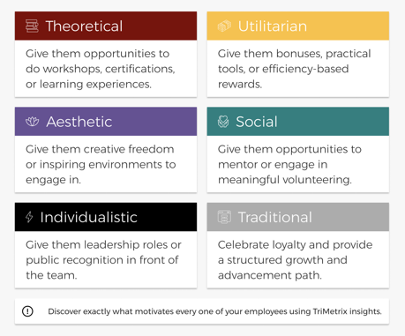
Management Tips Exercises

Slide 25
Action Handout – Management Tips

Slide 26
One Science in TriMetrix
Group Discussion –
Motivator Interview
Questions
The Key to
the Ferrari…

Slide 27

HIRING HELP
Some leaders think that with enough
training anyone can do the job…

Slide 28
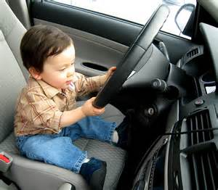

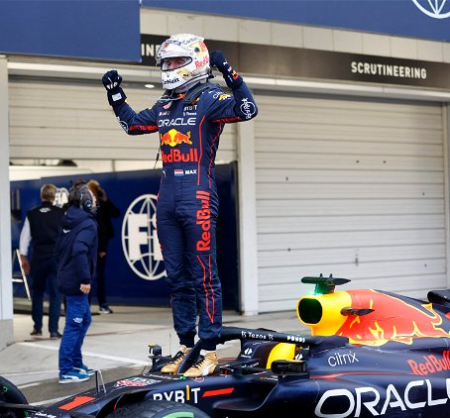
Make sure the candidate’s ”Gas in the Tank” match the job’s rewards…

Slide 29
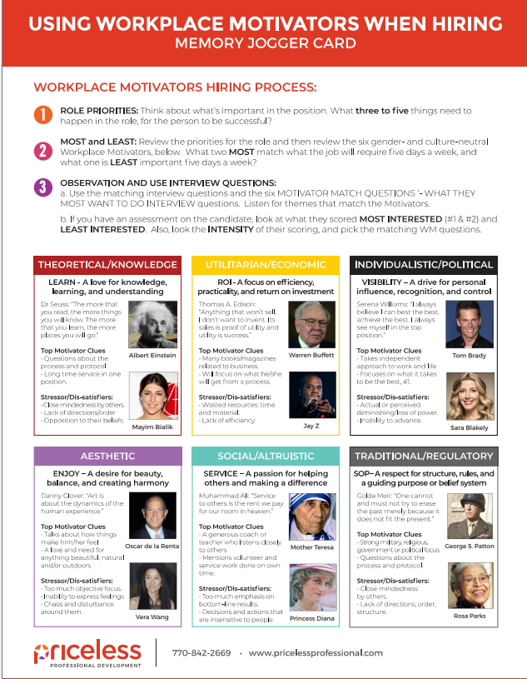
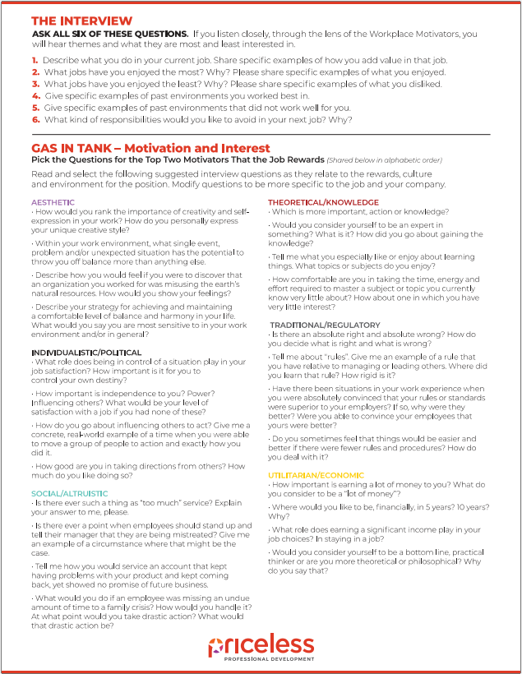

Slide 30
INTERVIEW QUESTIONS
Reveal if a Candidate’s Interests Match the Job
What jobs have you enjoyed the most? Why? Please share specific examples of what you enjoyed.
What jobs have you enjoyed the least? Why? Please share specific examples of what you disliked.
Give specific examples of past environments you worked best in.
Give specific examples of past environments that did not work well for you.
What responsibilities would you like to avoid in your next job? Why?
See 30+ Motivator-Related Interview Questions at
www.motivatorsppd.com

Slide 31
Action Handout – Motivator Interview Questions

Slide 32
One Science in TriMetrix
Group Discussion –
Review and
Wrap Up
The Key to
the Ferrari…

Slide 33
Our top motivators reveal what we are most interested in and how we want to spend our time, SEVEN DAYS a WEEK.
EXPERT
R.O.I.
ENJOY
SERVICE
STAND OUT
RULES
Notes:
Objective: To understand what the Driving Forces measure and how they can change.
Facilitation:
Review the list.
Ask participants, “If you inherited a 50 million dollar art collection, what would you do with it”?
Answer: most likely one of your primary Drivers Ex. Sell it/Resourceful, Study it/Intellectual, give to a museum/Harmonious.
Transition: Now that we understand the Driving Forces a little more, let’s set some session goals.

Slide 34

Benefits of Understanding Workplace Motivators
Helps to build stronger relationships
Increases appreciation for what is important to others
Helps you to include the viewpoint of others
Allows you to communicate more effectively
Raises satisfaction and fulfillment in work and life
Assists in hiring people that will be engaged in the culture
Supports managers to engage their staff and utilize their passions
Notes:
Objective: To see how understanding Driving Forces will benefit you personally and professionally.
Facilitation:
Read the list and ask participants which benefits would be most valuable to them.
Transition: Now that we see the benefits, let’s get clearer about what the Driving Forces measure.

Slide 35
At a base-level, we wonder…
"What am I here for in this world?
Why do I work for this organization?
How can this organization help me fulfill my meaning in the world?
How can I help this organization help me fulfill my meaning in the world?”
— Dr. Robert S. Hartman, Founder of the Science of Axiology, 1960’s

Slide 36
Action Handout – One Action Each for Self and Work

Slide 37
For Your #1 and #2 – For More Gas in Your Tank…
Theoretical/Knowledge. Are you learning new things and able to solve problems every day? Are you working on becoming an expert in something?
Utilitarian/Economic. Are your long hours paying off? Are you able to make more and get more results? Are you helping track ROI and eliminate waste of time and resources?
Individualistic/Political. Are you able to lead and be out front? Are you able to advance and receive recognition? In what ways can you be the spokesperson?
Social/Altruistic. Do you have time to coach, counsel, support, and help others? Are you involved in organizations with causes you care about?
Aesthetic. Are you able to correct imbalances in the business? Are you able to express your creative interests and explore self-improvement?
Traditional/Regulatory. Are you able to enforce order and structure in your world via policy, meetings, processes, and tradition? Are you able to stand by and share your beliefs?
Notes:
To sum up Motivators – make note of the questions next to the areas you scored #1 and #2. Use this self-awareness to manage your energy and motivation. Put more Gas in YOUR Tank, every day.

Slide 38
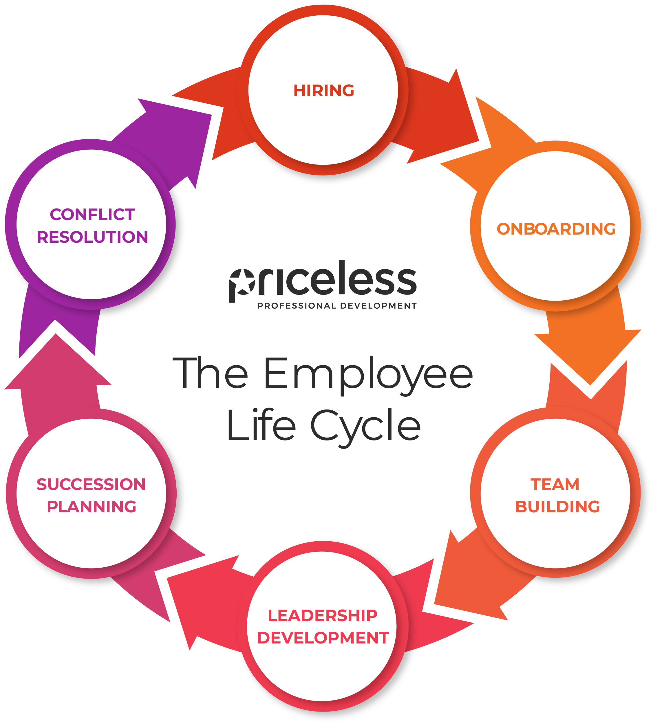
Use motivators insight throughout the entire employee lifecycle.

Slide 39
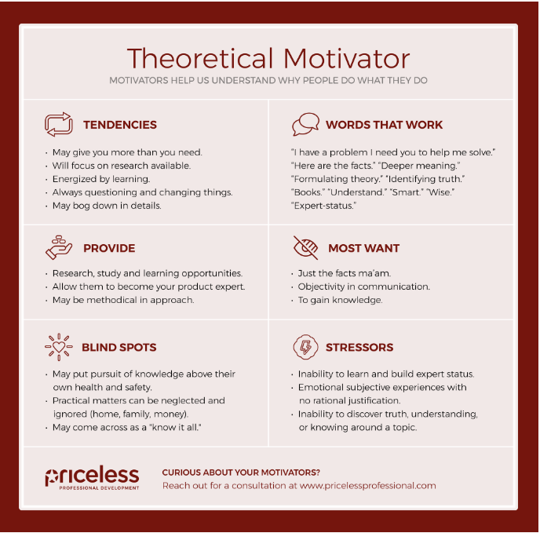

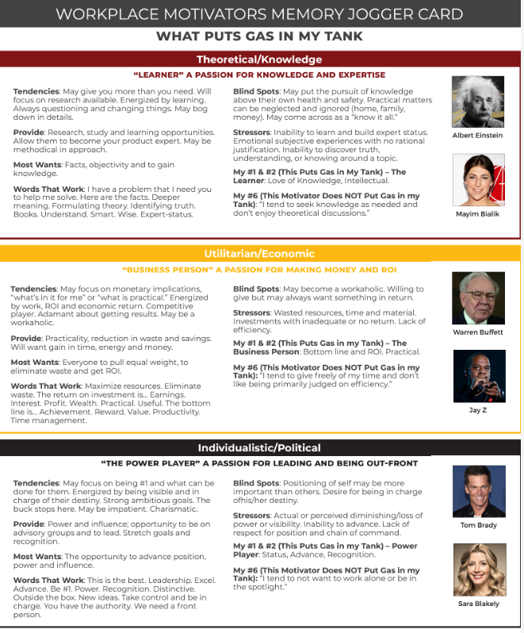
Resources: www.motivatorsppd.com
For Hiring: Workplace Motivators Interview Questions
For Sales: Using Motivators to Improve Sales
For Leaders: Specific Management Tips
Personal Growth:
How Each Motivator Reacts in Crisis
Find the Perfect Hobby and Perfect Gift
Best Volunteer Opportunities

Slide 40
What is normal for you and your team is…
enthusiasm.
laughing a lot, many times a day.
to feel strong, sure, confident, and secure.
to have so much energy at the end of the day that
you're looking for more good things to do.
to have such passion for life that when you're with other people,
you're eager to hear about what they're doing and how they're doing it.
to have so much energy at the end of the day, you’re
already eagerly planning tomorrow.
feeling disappointed that the sun goes down and
enthusiastic that the sun comes up.

Slide 41


Slide 42
This is what was most useful to me today…
Here’s one area of expansion for me…

Slide 43
Follow Up
Resources
Post-work/Follow-up:
Share the online resource to all: www.motivatorspdd.com
Share the Motivators Team Report (Sample Team Report)with the appropriate parties. Hold a separate discussion and review as helpful.
If you also have DISC reports on Participants
fill in and share the Talent Tracker

Slide 44
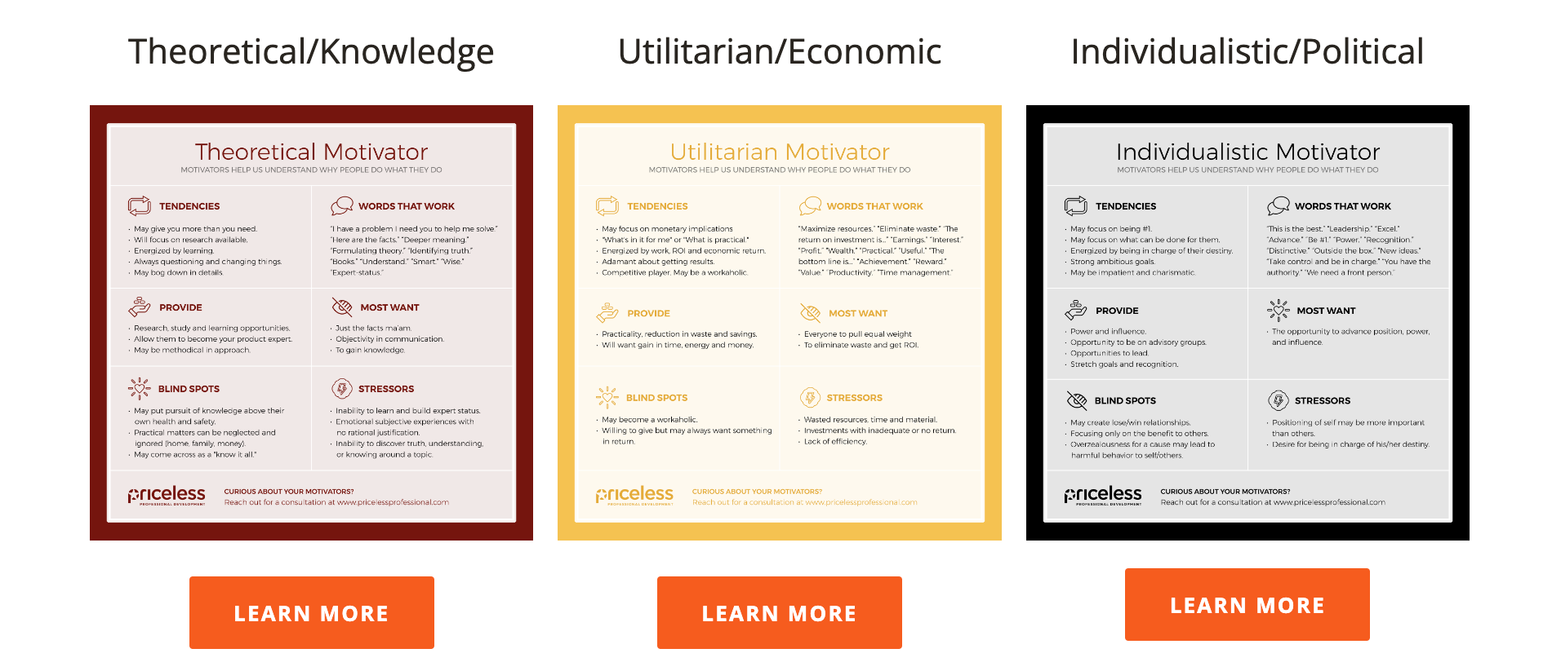
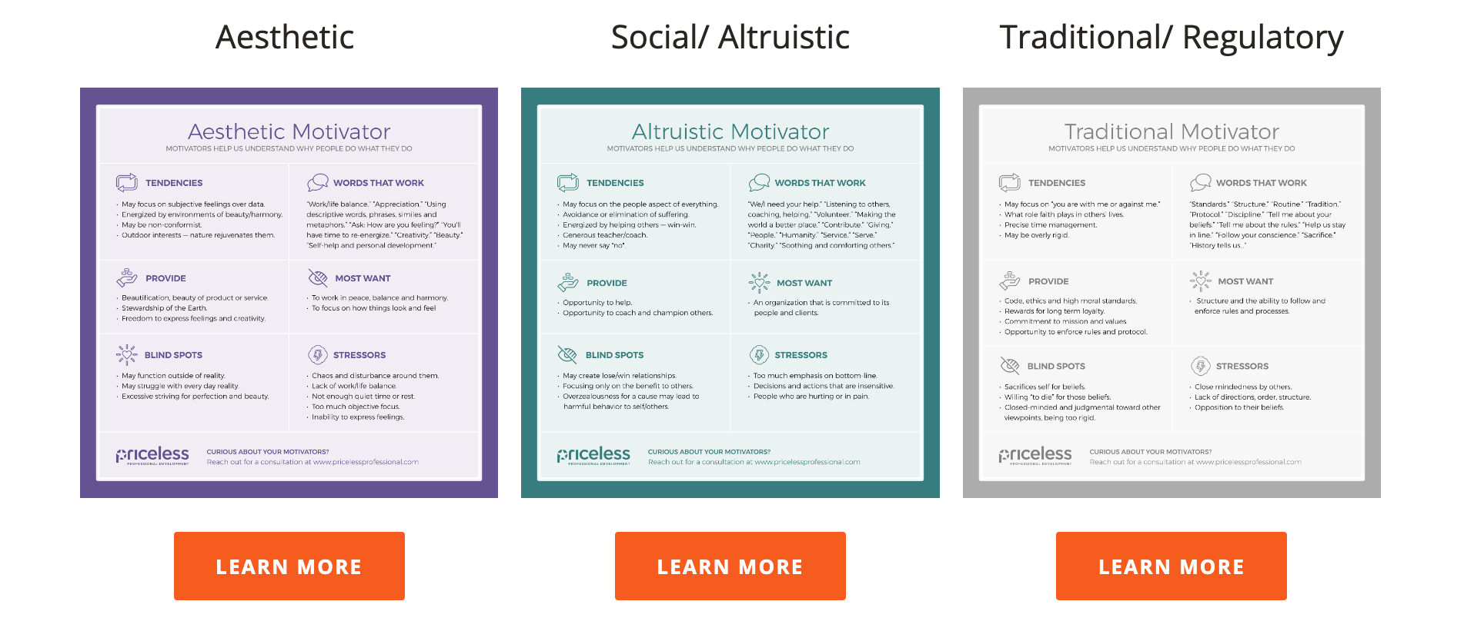
WORKPLACE MOTIVATORS
Insights and Exercises for Teams
Employee’s Energizers and Exhausters: Team Members Review Energizers and Stressors; Determine – What You Want to Do More Of and What You Want to Delegate
Leader’s Delegation Proclamation: Review Teams Top Motivators; Reviews Tasks and Projects; Create Delegation Suggestions, Discuss with the Team
Resolving Conflict: Reviewing Each Person’s Viewpoint, Sharing Top Motivators, What Each Person Wants the Other Person to Understand, Discuss Potential Fixes
www.motivatorsppd.com

